Slide 1

BIOENERGY AND DEVELOPMENT
Forum 2: Sustainable biofuels: avoiding the food vs fuel trap with alternative feedstocks.
October 19th 2015
Berlin, Germany
Linda Davis, Ph.D Head, Stakeholder Relations l.davis@smartcookenergy.com Cell: +254 717 727 103
©2015 SmartCook Energy Limited | CONFIDENTIAL – DO NOT DISTRIBUTE

Slide 2
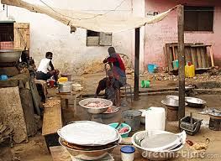
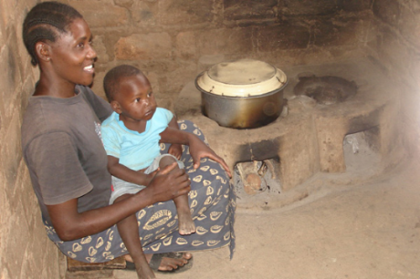
PROBLEM STATEMENT
URBAN COOKING IS A HUGE MARKET IN AFRICA
$12 Billion market $30 per month household spend 30+ million African urban households (80%) 40 African cities
However resulting in…..
Loss of forest cover Increased GHG Emissions Negative health impacts

Slide 3
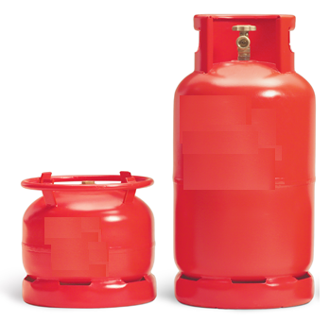
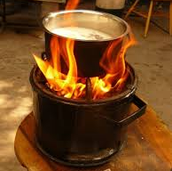
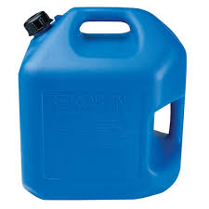
PROBLEM STATEMENT
COOKING FUEL OPTIONS IN URBAN AFRICAN ENVIRONMENTS
LPG $3 B.
CHARCOAL $12 Billion
KEROSENE $5 Billion
Notes:
Terrible smell
Poor safety
Pressurized stoves often cause slum fires
Subsidized
Expensive
Infrastructure investment
Upfront cost of LPG cooking equipment
Poor mass-market safety brand
Requires subsidies
Not for the mass market
Cylinder management costs increase significantly with smaller cylinder sizes

Slide 4
INTRODUCING SMARTCOOK
SMARTCOOK ENERGY
A hardware and software fuel distribution technology company enabling a faster, cheaper and cleaner cooking fuel than charcoal and kerosene.

Slide 5
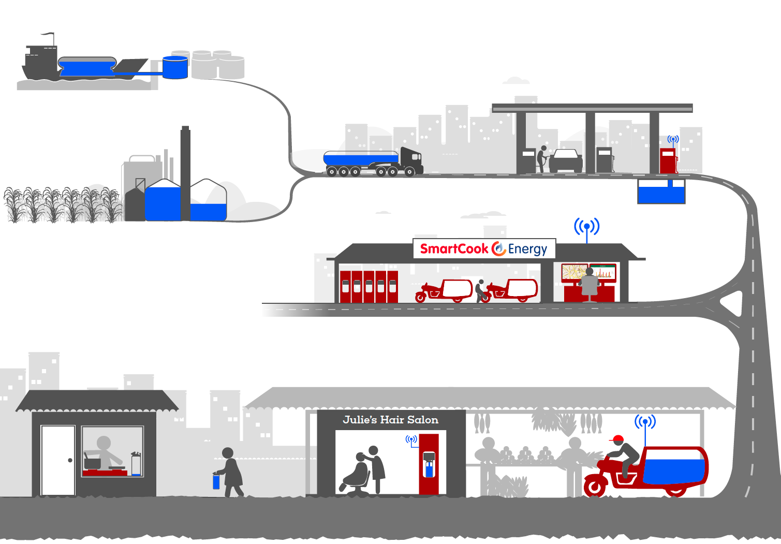
AT-A-GLANCE
SMARTCOOK’S TECHNOLOGY & BUSINESS MODEL INNOVATIONS
ETHANOL SUPPLY
FUEL DEPOT
CONTROL ROOM
STOVE & CANISTER
FUELPOINT
MICROTANKER

Slide 6
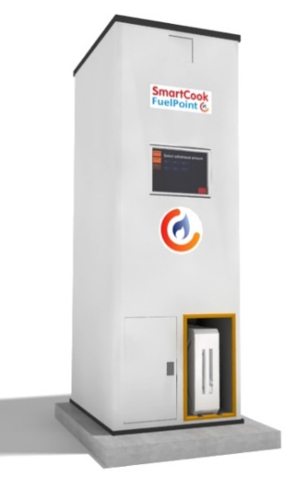
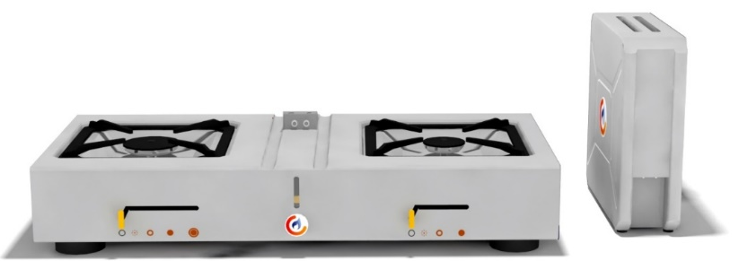

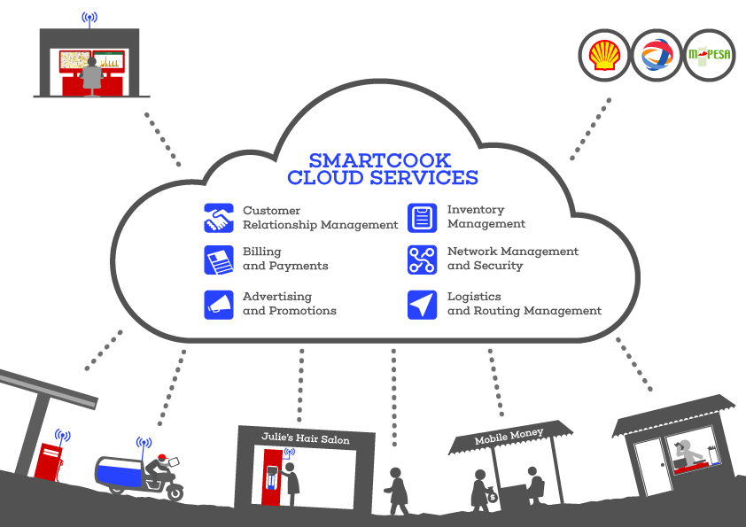
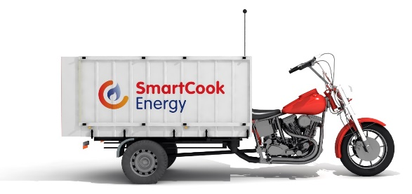
SMARTCOOK HARDWARE AND SOFTWARE SUMMARY

Slide 7
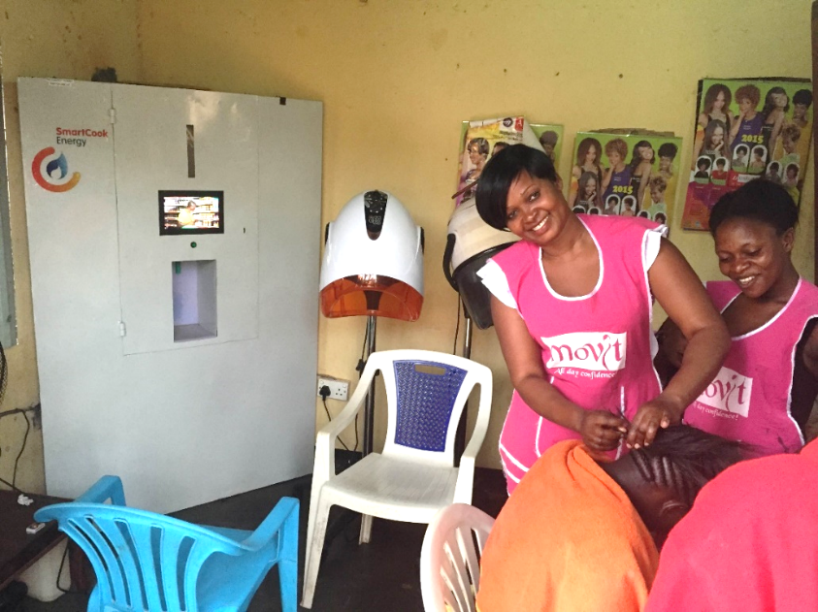
FUELPOINT PROTOTYPE OPERATING IN TARGET MARKET
Currently serving test customers in Mary’s Salon in Kitintale, Kampala

Slide 8

SOLUTION IMPACT
IMPACT OF ETHANOL COOKING ON SDGS
Smartcook’s solution is relevant to 5 SDGs
Affordable, reliable, sustainable and modern energy for all
Make cities and human settlements inclusive, safe, resilient and sustainable
Ensure sustainable consumption and production patterns
Action to combat climate change and its impacts
Protect, restore and promote sustainable use of terrestrial ecosystems

Slide 9

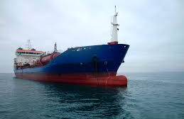
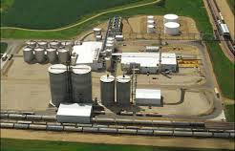
SUPPLY CHAIN STRATEGY
SMARTCOOK ROLLOUT PLAN
Phase 1- Current Local Supply
Phase 2 – Imported Ethanol
Phase 3 – Future Local Supply

Slide 10
PHASE 1: ROLL OUT LOCAL SUPPLY
Number of customers = 10,000
4 Cities = Nairobi, Kampala, Dar- es – salaam and Mombasa
Schedule = July – Dec 2016
Current Production: Approximately 5ML (Industrial Grade) from 6 plants
Feedstock: Molasses a by product of sugar production

Slide 11
PHASE 2: ROLL OUT IMPORTED ETHANOL
Number of customers = 1,000,000
4 Cities = Nairobi, Kampala, Dar-es – salaam and Mombasa
Schedule = End of Q4, 2017
Supply: Local production and imported ethanol

Slide 12

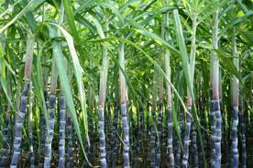
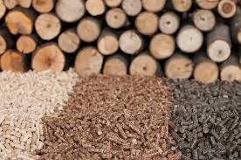
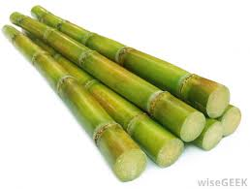
PHASE 3: PRIMARILY LOCAL SUPPLY
Feedstock: Various e.g.,
Molasses
Sugarcane juice
Cane stock
Woody biomass
Production: From 6 ethanol plants processing molasses to several in East Africa

Slide 13
BIOENERGY AND DEVELOPMENT
Forum 2: Sustainable biofuels: avoiding the food vs fuel trap with alternative feedstocks.
October 19th 2015
Berlin, Germany
Linda Davis, Ph.D Head, Stakeholder Relations l.davis@smartcookenergy.com Cell: +254 717 727 103
©2015 SmartCook Energy Limited | CONFIDENTIAL – DO NOT DISTRIBUTE

